Slide 1
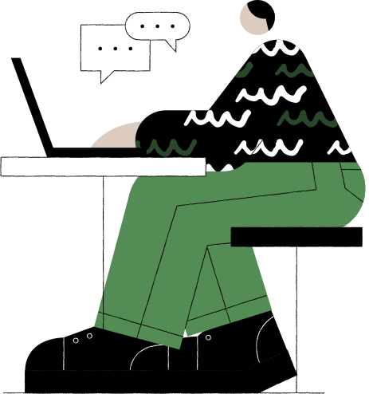
Social Media Report
Quarterly Performance and Assessment

Slide 2
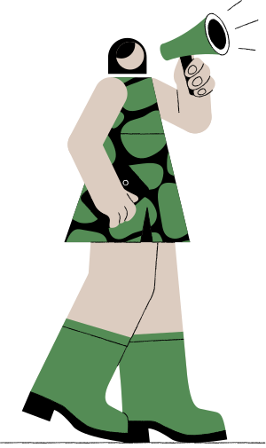






Slide 3


Slide 4



Likes
Engagements
Mentions
Presentations are communication tools that can be used as demonstrations, lectures, speeches, reports, and more. It is mostly presented before an audience.
Presentations are communication tools that can be used as demonstrations, lectures, speeches, reports, and more. It is mostly presented before an audience.
Presentations are communication tools that can be used as demonstrations, lectures, speeches, reports, and more. It is mostly presented before an audience.

Slide 6
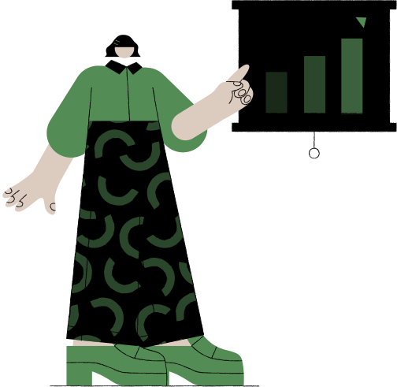
Overall increase in engagement
Presentations are communication tools that can be used as demonstrations, lectures, speeches, reports, and more. It is mostly presented before an audience.

Slide 7

Informational Tweet
Campaign Tweet
Engagement Tweet
Presentations are communication tools that can be used as demonstrations, lectures, speeches, reports, and more. It is mostly presented before an audience.
Presentations are communication tools that can be used as demonstrations, lectures, speeches, reports, and more. It is mostly presented before an audience.
Presentations are communication tools that can be used as demonstrations, lectures, speeches, reports, and more. It is mostly presented before an audience.

Slide 8
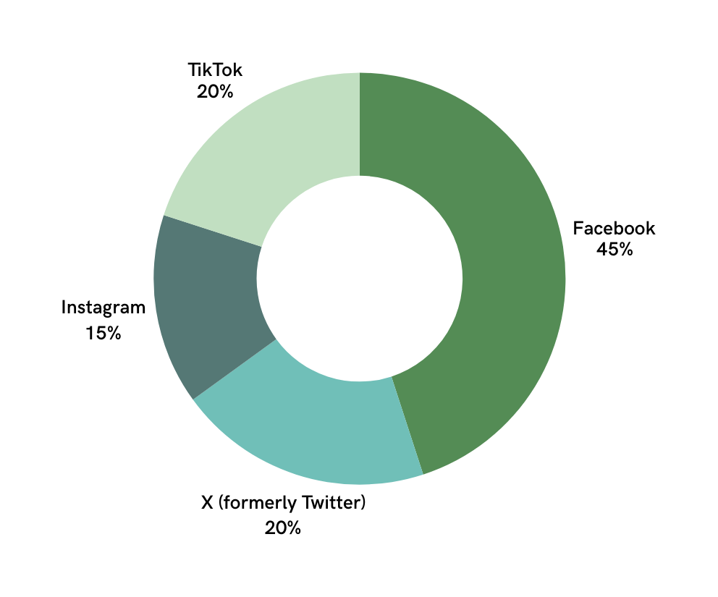
Distribution per
social media channel
Paragraph that explains the data sources, outlines what the chart illustrates, and provides guidance on interpreting the visualizations to inform decision-making.

Slide 9
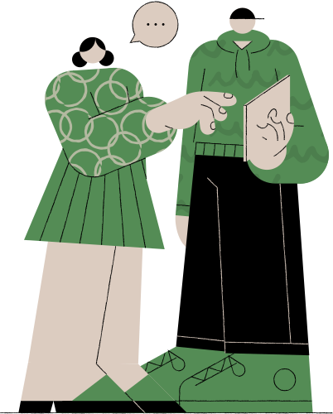

Slide 10
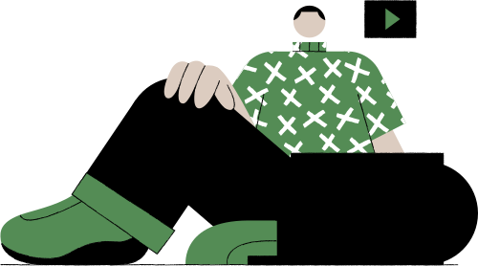

Slide 11
Brand Awareness
HR Recruitment
Brand
Engagement
Professional
Network
Presentations are communication tools that can be used as demonstrations, lectures, speeches, reports, and more. It is mostly presented before an audience.
Presentations are communication tools that can be used as demonstrations, lectures, speeches, reports, and more. It is mostly presented before an audience.
Presentations are communication tools that can be used as demonstrations, lectures, speeches, reports, and more. It is mostly presented before an audience.
Presentations are communication tools that can be used as demonstrations, lectures, speeches, reports, and more. It is mostly presented before an audience.

Slide 12
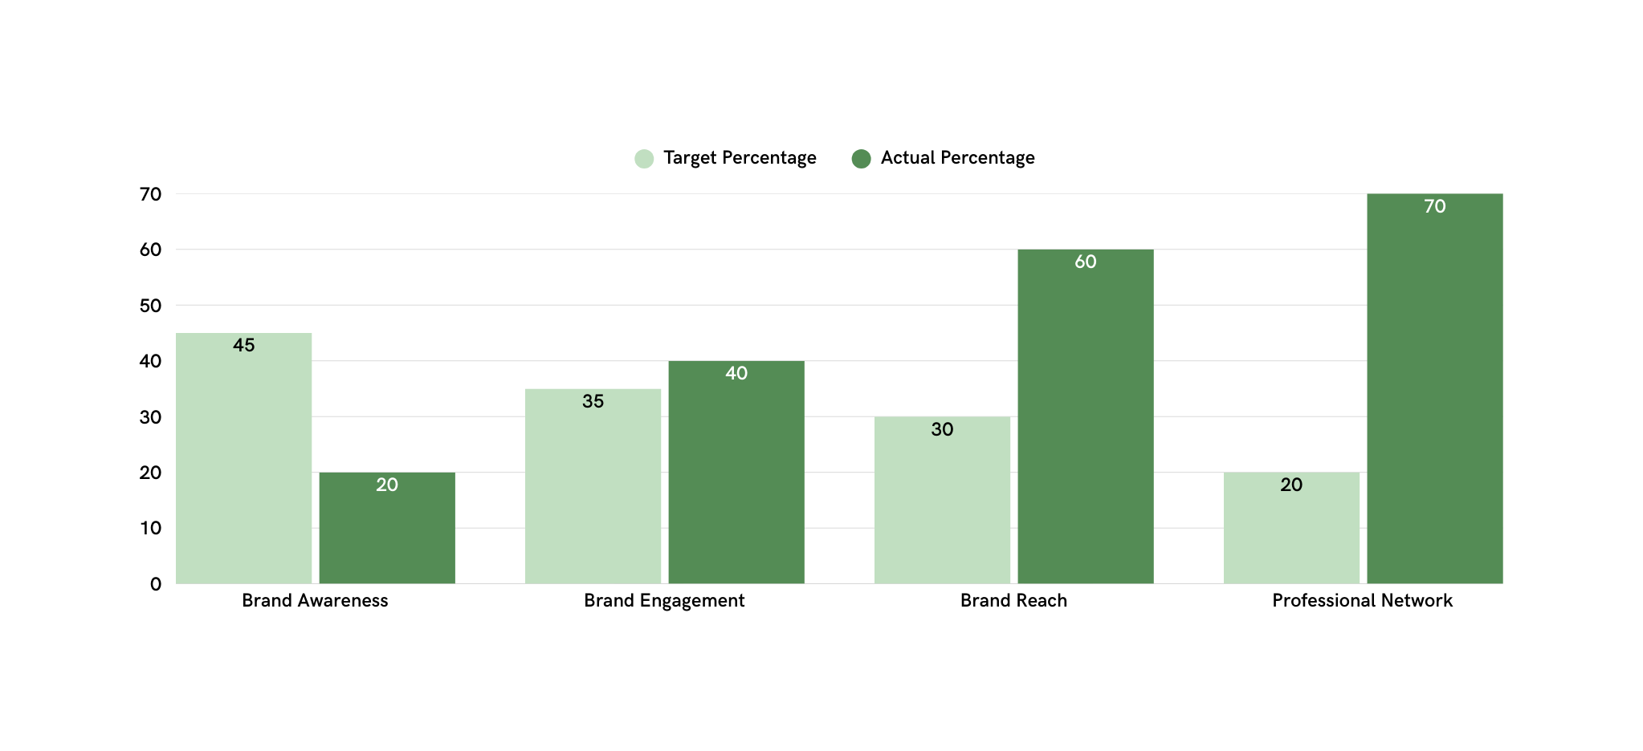
Goal Percentage Comparison
Subheading that highlights the focus of the charts and sets context for the data presented.

Slide 13
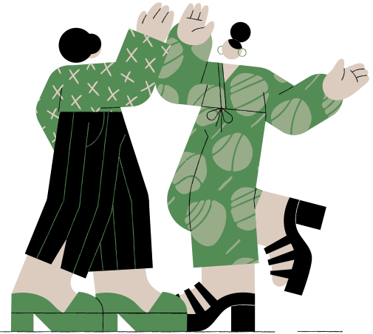
Overall
Performance
What we did right
Audience Growth
Content Plan
New Campaigns
New Channels
Interaction & Feedback

Slide 14
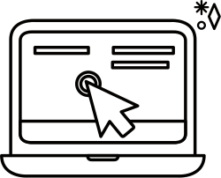

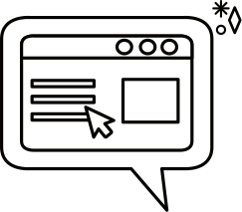
Maximize Platforms
Presentations are communication tools that can be used as demonstrations, lectures, speeches, reports, and more. It is mostly presented before an audience.
Incentivize Engagement
Presentations are communication tools that can be used as demonstrations, lectures, speeches, reports, and more. It is mostly presented before an audience.
Encourage Feedback
Presentations are communication tools that can be used as demonstrations, lectures, speeches, reports, and more. It is mostly presented before an audience.

Slide 15
Optimize
Presentations are communication tools that can be used as demonstrations, lectures, speeches, reports, and more.
Launch
Presentations are communication tools that can be used as demonstrations, lectures, speeches, reports, and more.
Next Quarter Timeline
Run
Presentations are communication tools that can be used as demonstrations, lectures, speeches, reports, and more.
Strategic Plan
Refine
Presentations are communication tools that can be used as demonstrations, lectures, speeches, reports, and more.
Analyze
Presentations are communication tools that can be used as demonstrations, lectures, speeches, reports, and more.

Slide 16



Meet the Social Media Team
Report Authors
Violla Bertson
Nestore Intigua
Olga Tronilsky
Lead analyst
Campaign strategist
Creative lead

Slide 17
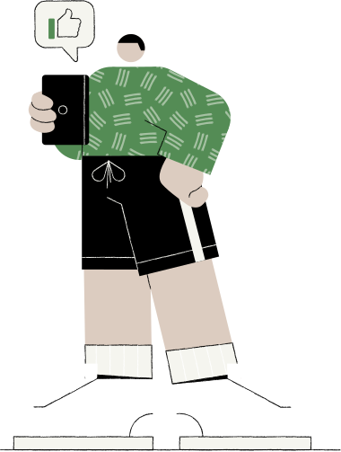
Phone Number
Contact us
123-456-7890
Email Address
For questions or comments
hello@reallygreatsite.com
Website
www.reallygreatsite.com

Slide 18
“Success begins in the mind; envision it, and your path will follow.”
— Laurence Yáo

Slide 19

























Resource Page
Use these in your presentation.
Delete or hide this page before presenting.

Slide 20
B for blur | C for confetti
D for a drumroll | M for mic drop
O for bubbles | Q for quiet
U for unveil | Any number from 0-9 for a timer
Resource Page
Find the magic in presenting. Select these keys while in Present mode.
Delete or hide this page before presenting.

Slide 21
Go to Uploads, then Record Yourself.
All recordings will be saved on Canva in your Uploads folder.
Edit your recording. Feel free to adjust the background, volume, and duration.
Need multiple presenters? Select Share then update Collaboration link to Can edit.
Share editable link. Assign team members to record their sections.
You can also mix live presentation and recorded videos to make your session more engaging.
Resource Page
Want more flexibility as a presenter? Record your presentation to engage in a way that works for you — and let your audience watch in a way that works for them.
Delete or hide this page before sharing.

